Slide 1
Closing the Fiscal Gap
Tax and Expenditure Limitations and Local Debt
John Mikesell, Chancellor’s Professor, Indiana University
Daniel Mullins, Ph.D., EY National Director, State & Local Tax Policy Economics
Marvin Ward, Ph.D., Congressional Budget Office
Chad Smith, Ph.D. candidate, American University / EY

Slide 2
Plan of Attack
Why study tax and expenditure limitations?
What implications might they have for local debt activity?
What have we seen so far?
What makes this study different?
Do TELs influence the volume of new debt issues?
How sensitive are these estimates to variance in specification?

Slide 3
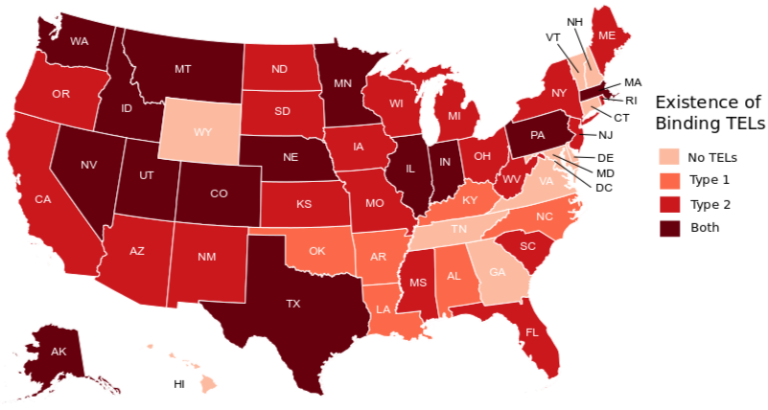
Why Study Tax and Expenditure limitations?
Tax and Expenditure Limitations by State (2009)
TELs have a long history, though most of their proliferation has occurred in the last 40 years.
TELs are usually applied at the state level. There is significant within-state variation in fiscal circumstances.
TELs restrict the options for revenue generation and resource allocation, but they cannot alter the dynamic preference schedule of the population.

Slide 4
What Implications Do TELs Have for Local Debt Activity?
In practice, TELs generally decrease revenue by construction. There is little empirical support for a commensurate reduction in public service demand.
Government efforts to leverage non-tax revenue sources can only partially cover shortfalls.
TELs are often focused on the property tax, frequently with exemptions for debt service.
Accumulation of GO debt is often constrained independent of any existing TELs.

Slide 5
Chad to replace

Slide 6
What Have We Seen So Far?
Voters often support TELs because they desire lower tax burdens (Alm and Skidmore 1999)
TELs generally depress revenue (Ballal and Rubenstein)
Voters expressed buyer’s remorse when post-Prop 2.5 revenue resources could not finance desired expenditures (Cutler, Elmendorf, and Zeckhauser 1997)
Revenue limits increase debt service costs while expenditure or debt limits decrease debt service costs (Johnson and Kriz 2005)
TELs increase reliance on non-tax sources of revenues (fees and charges, IG revenue from the state, and debt) (Mullins & Joyce 1996)
The literature on TELs and debt that focuses on inter-local effects is relatively sparse.

Slide 7
What Makes This Study Different?
Data
Method
Extensive database of TEL restrictions over time for all states
Proprietary, issue-level data that contains over 450k state and local bond issues between 1984 and 2014
Publicly available socioeconomic data from the USA counties database (discontinued in 1990)
Final modeling set has 21,816 observations aggregated to the county level over the 1990-2010 time period
Fixed effect, weighted panel regression evaluate the continuous effect
Topline results focus on TELs by type and feature two-way fixed effects (state and year)
Specifications in the “Many Models” effort vary by dependent, TEL representation, and fixed effect treatment (780 combinations)
Logistics and regularized Support Vector Classification estimators seek to identify drivers of the discrete effect

Slide 8
General Model
debt_issue ~ TELs + fiscal_supply + fiscal_demand + fiscal_stress +econ_environment
Concept | Variables
Logged Per Capita GO Debt Issued | GO*LN
Logged Per Capita RV Debt Issued | RV*LN
Ratio of GO Debt Per Capita to Total Debt Per Capita | GO*PROP_LN
Binary Issue Indicator | BIN_DEBT
Concept | Variables
Any TEL | LIMITS
Non-Binding TEL | TYPE1
Potentially Binding TEL | TYPE2
Both TYPE1 & TYPE2 | BOTH
Years Since TYPE2 Enacted | TYPE2_Y
Overall Property Tax Rate Limit | RATE_L
Overall Assessment Limit | SC_LMT
Limit Applied to General Purpose Governments | GP_LMT
Limit Applied to School Districts | SC_LMT
Covariate variables account for concepts including (but not limited to) population dynamics, the income distribution, employment, and prevailing interest rates at the national and county levels.

Slide 9
Do TELs Influence the Volume of New Debt Issues?
Yes, but we did not find an effect as large as we expected.

Slide 10
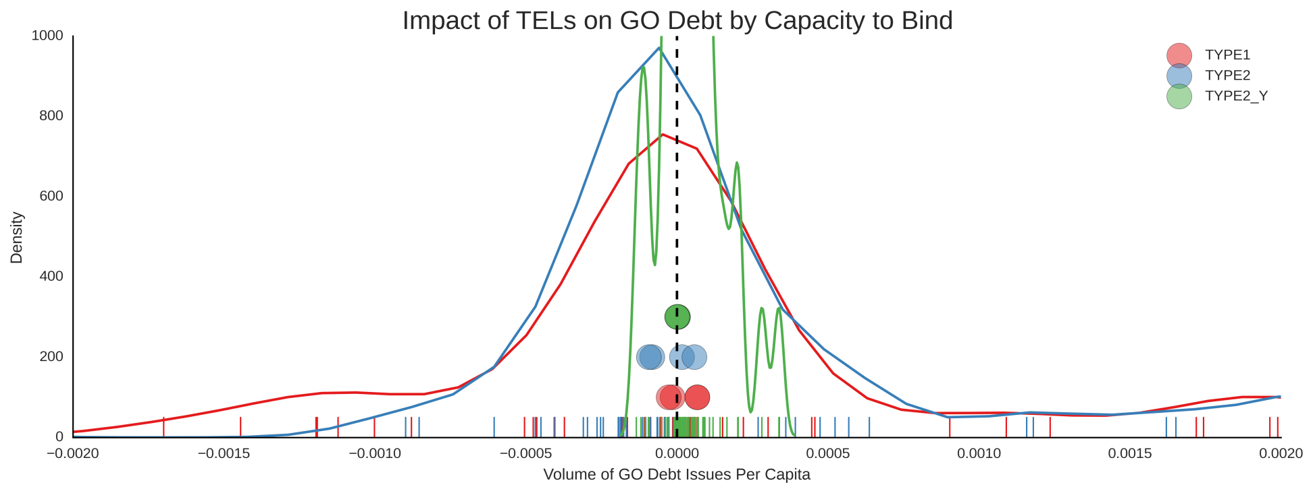
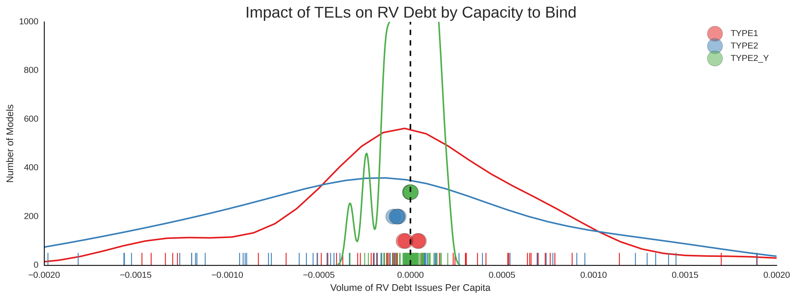
How Sensitive Are These Estimates?

Slide 11
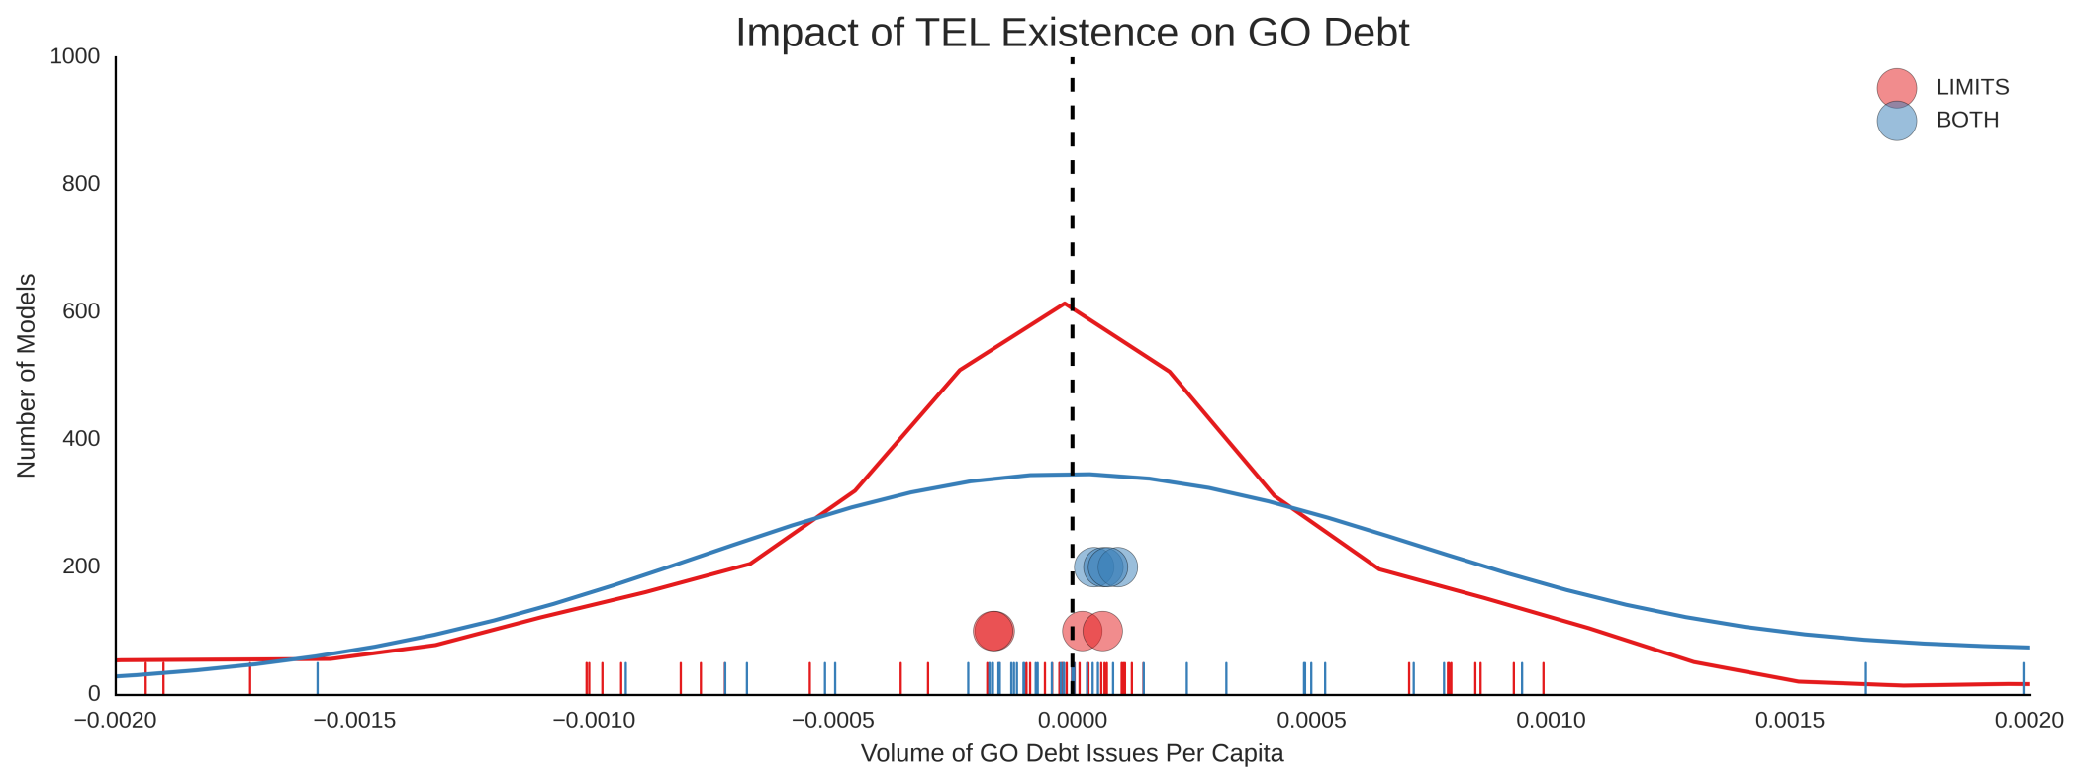
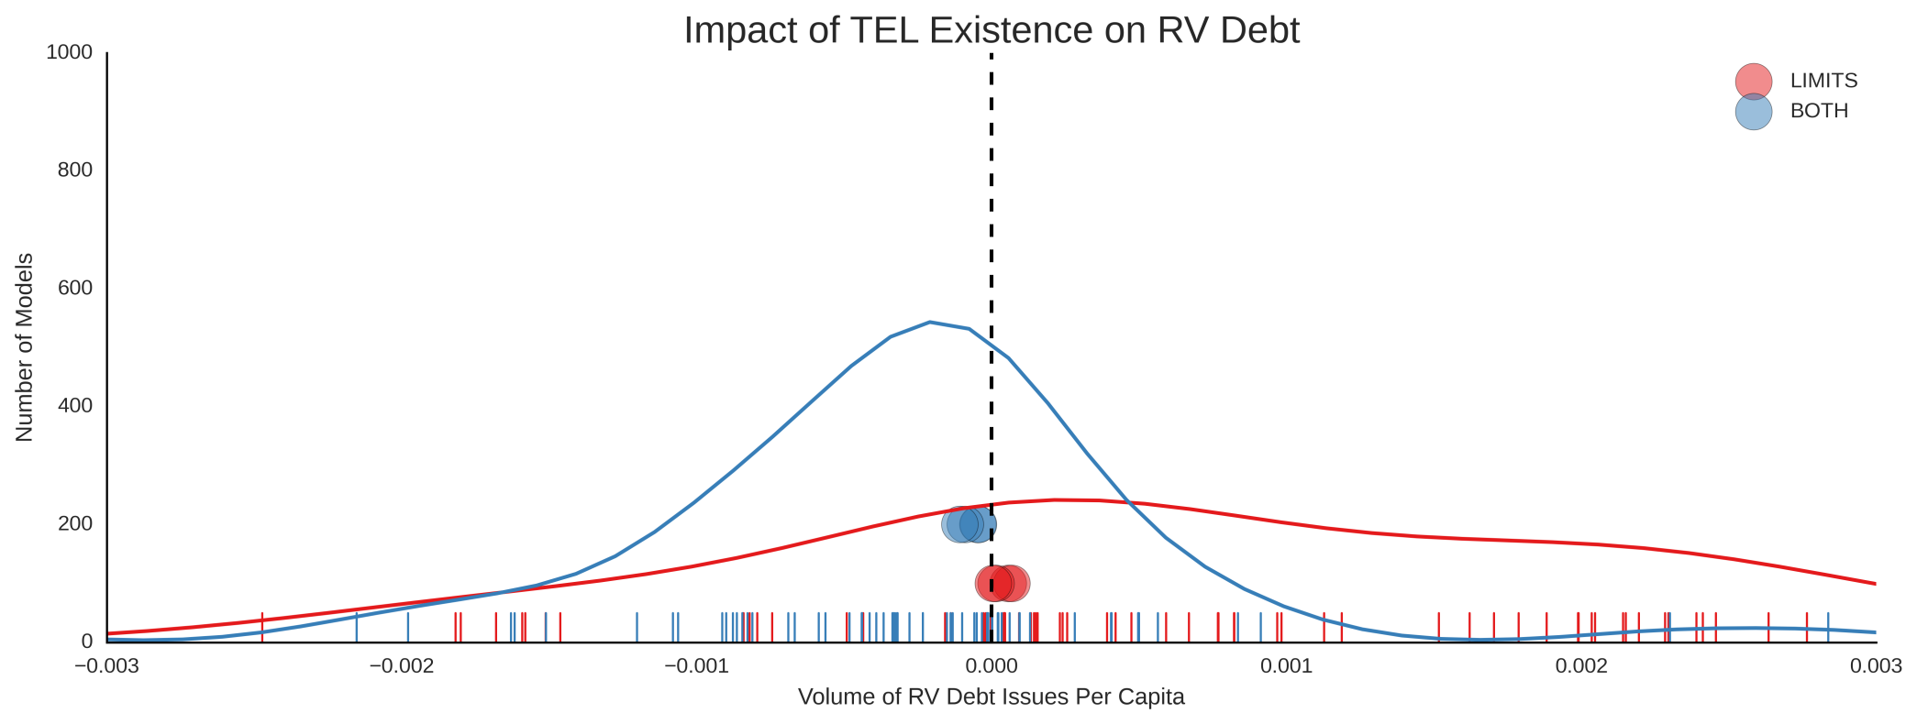

Slide 12
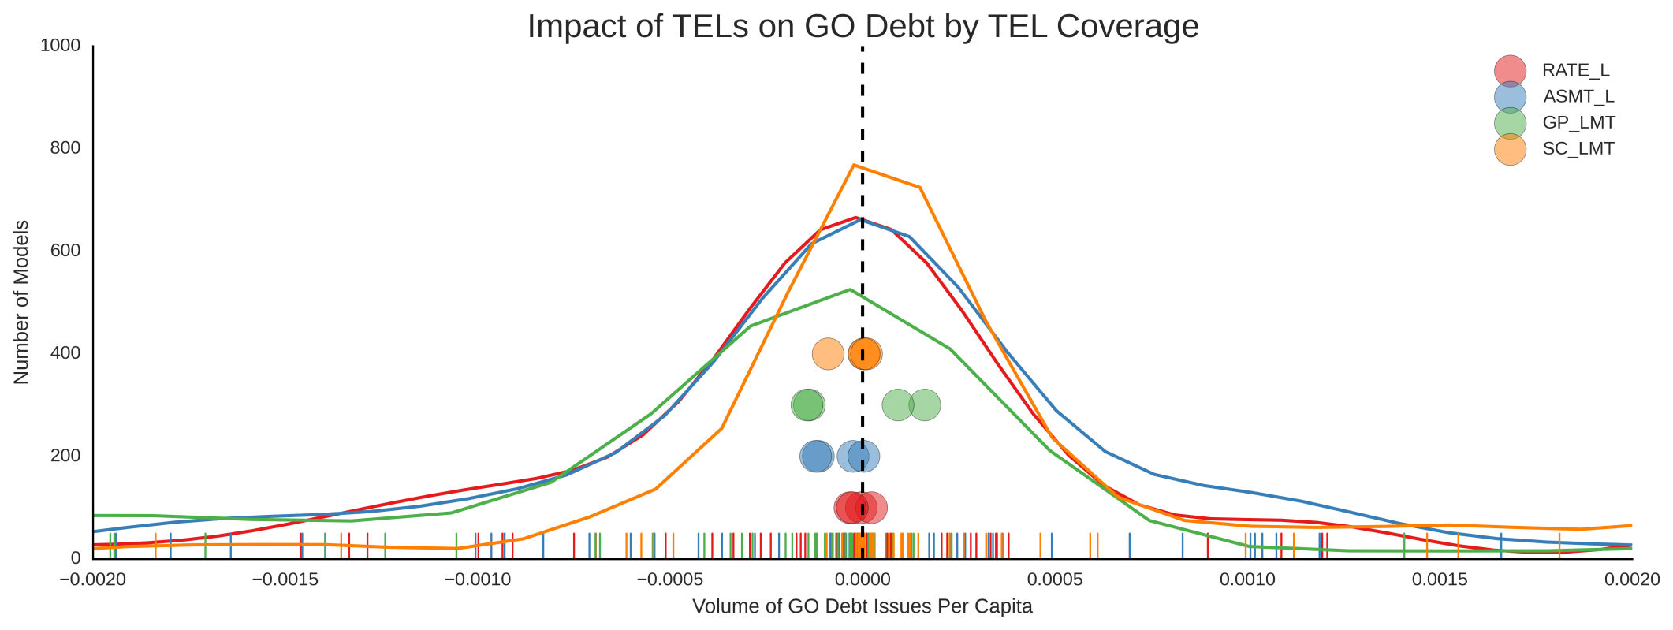
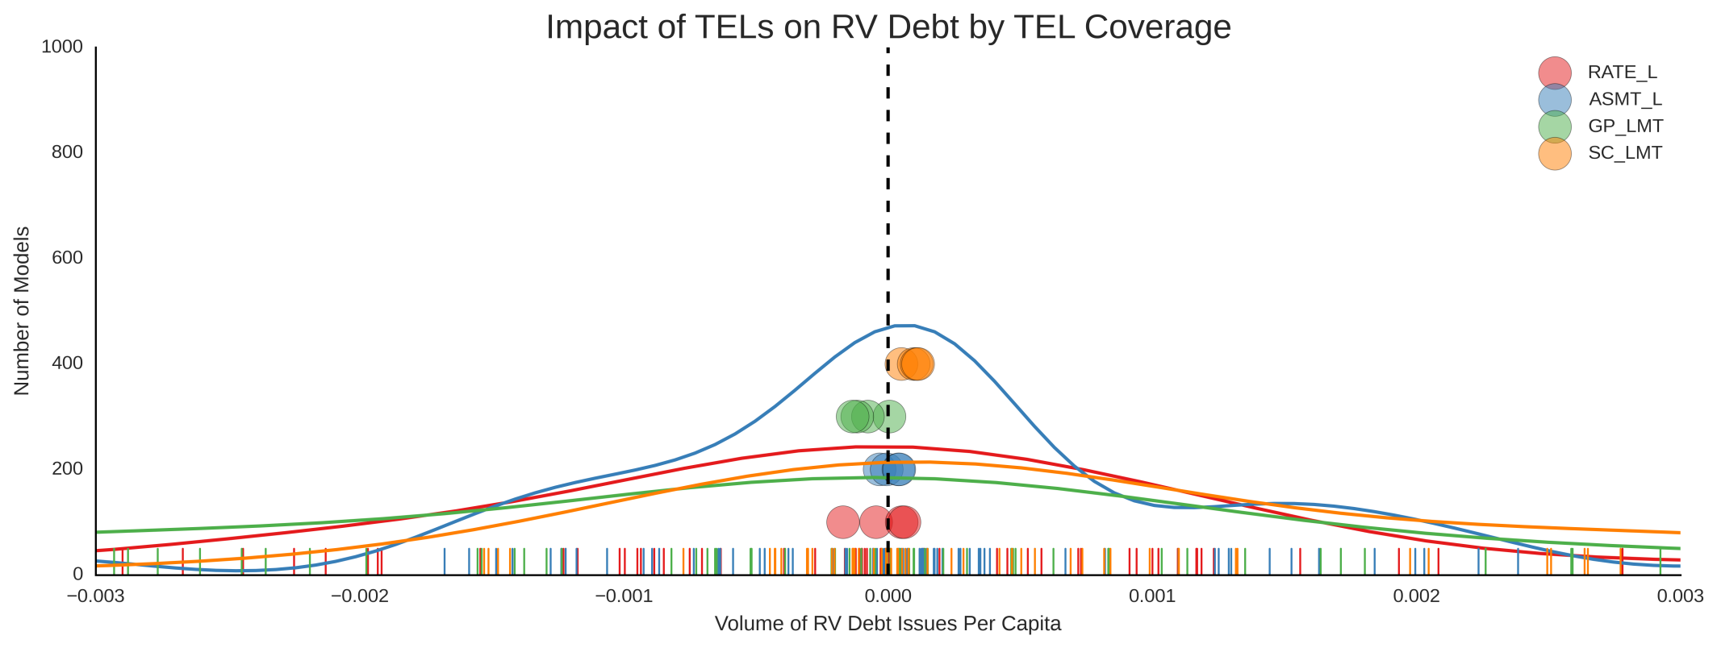

Slide 13
Conclusions
TELs are associated with increases in debt issues
Binding TELs are associated with increases in GO proportions
The use of GO debt increases with time in counties with binding TELs
Estimates vary significantly with specification, issuer type, and/or debt purpose
Find our project on Github! https://github.com/choct155/TELs_debt

